Slide 1
BPN for Medical Image Diagnosis
By Radhika Bailurkar
UID: 2019430003

Slide 2
Back Propagation Network
Backpropagation is the method of fine-tuning the weights of a neural net based on the error rate obtained in the previous epoch.
Proper tuning of the weights allows you to reduce error rates and to make the model reliable by increasing its generalization.

Slide 3
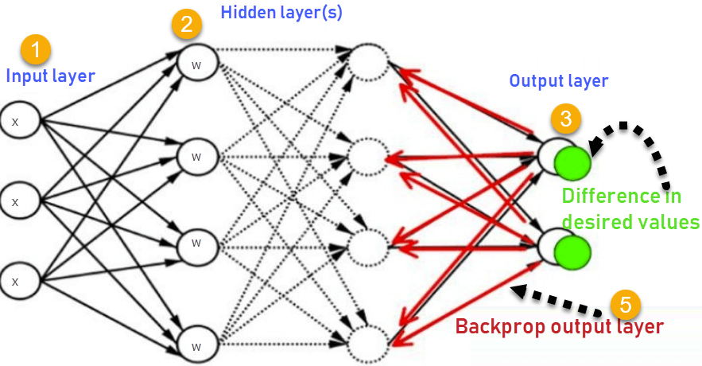
How BPN works

Slide 4
Image Processing
Image processing is a method to perform some operations on an image, in order to get an enhanced image or to extract some useful information from it.
Importing the image via image acquisition tools;
Analysing and manipulating the image;
Output in which result can be altered image or a report which is based on analysing that image.

Slide 5
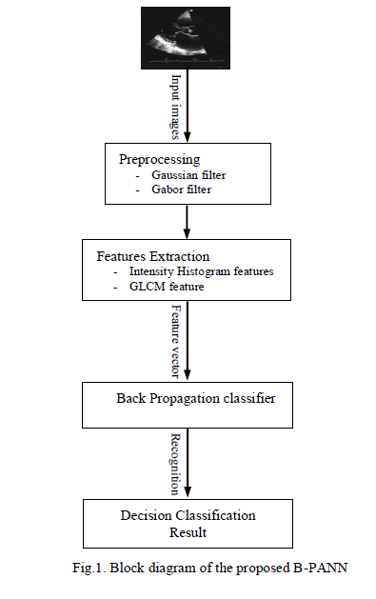
Artificial Neural Networks in Medical Images for Diagnosis Heart Valve Diseases

Slide 6
Artificial Neural Networks in Medical Images for Diagnosis Heart Valve Diseases
The BPN has 3 layers: input, hidden and output layer
The no of neurons in input layer is determined by no of features selected.
The no of neurons in output layer is determined by the classes represented in nw
The no of hidden neurons is calculated by the highest performance found.

Slide 7
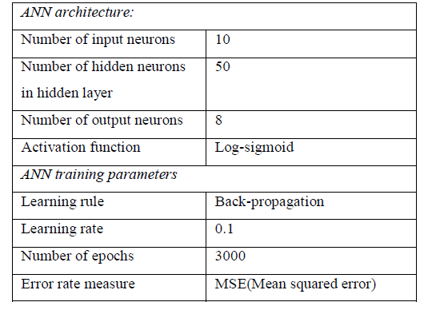
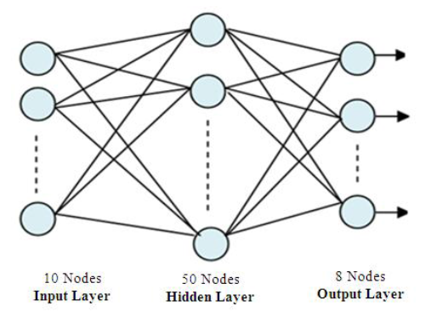
Artificial Neural Networks in Medical Images for Diagnosis Heart Valve Diseases

Slide 8
Conclusion
BPN can be used to identify the error and adjust the weights accordingly to achieve the output .
We

Slide 9
References
https://www.geeksforgeeks.org/digital-image-processing-basics/
https://skymind.ai/wiki/backpropagation
Atta Elalfi, Mohamed Eisa, Hosnia Ahmed“Artificial Neural Networks in Medical Images for Diagnosis Heart Valve Diseases”, IJCSI International Journal of Computer Science Issues, Vol. 10, Issue 5, No 1, September 2013

Slide 10


